Slide 1
Using Electrochemical Simulation to both Optimize Alloy Electroplating and Predict the Consequent Impact on Product Corrosion Resistance
Alan Rose Ph.D., Siva Palani Ph.D., Keith Legg Ph.D., Ashok Vaishnav Ph.D., Julio Mendez Ph.D.

Slide 2
Agenda
Problem
  Replacement of hazardous corrosion resistant coatings
  Transition challenges
Modeling Approach
Simulations
  Plating
  Corrosion
  Validation & Verification
Summary

Slide 3
Simulations show the WHAT and HOW
WHAT
  evaluating what we need in the field to achieve product corrosion resistance
HOW
  optimizing manufacturing process to establish how the correct coating should be plated

Slide 4
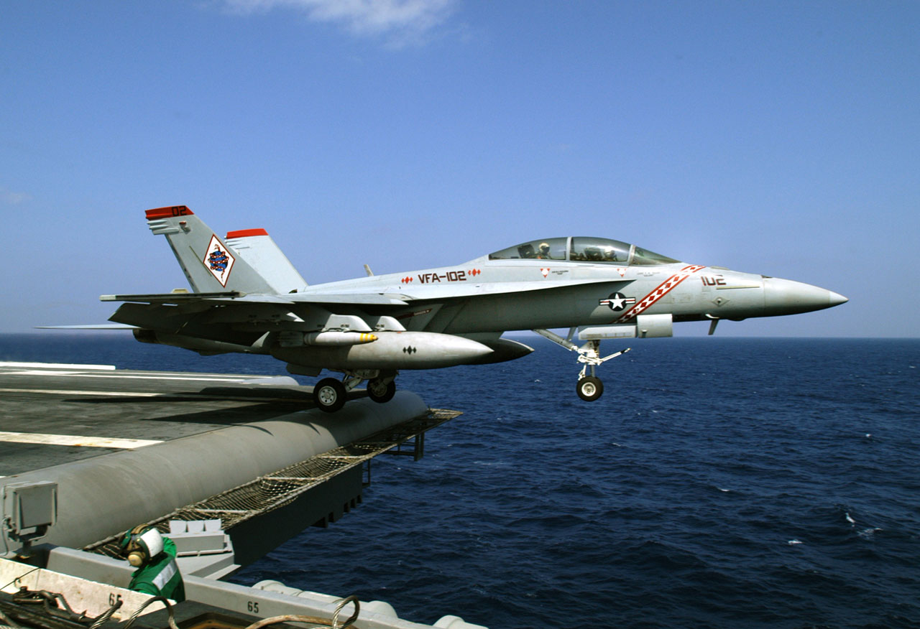
The Corrosion Problem
Annually
Cost
  $20.9bn
The NACE 2016 IMPACT study estimates the global cost of corrosion to be $2.5 trillion which is equivalent to 3.4% of the global gross domestic product (2013).
It is estimated that savings of 15%-35% of this cost could be realized by implementing corrosion control and better design practices.
Safety
Readiness
  25 days unavailable

Slide 5

Harsh environments - USS Kitty Hawk
https://youtu.be/Z0Jzb8dfcC4

Slide 6
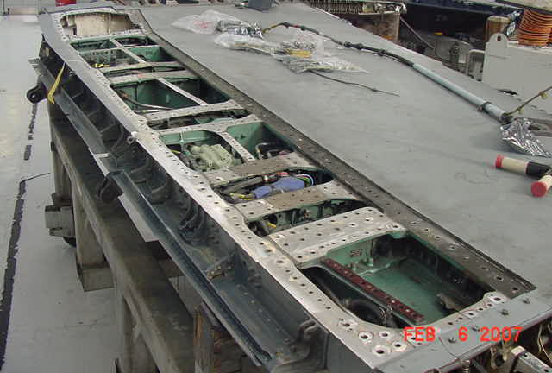
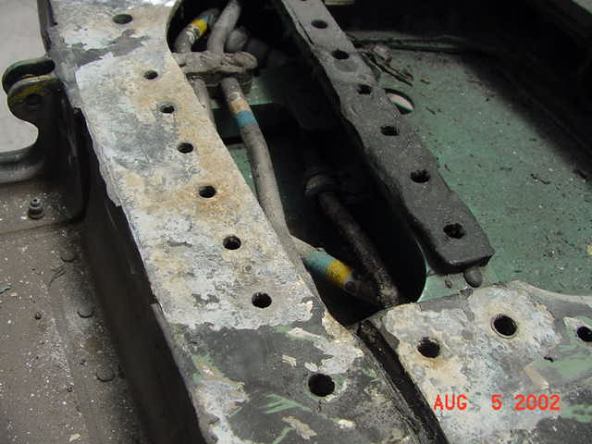
F-18 wing and airframe corrosion
More than 80% of military aircraft structural failures are initiated from corrosion pits
Repair: remove corrosion and bush hole with PH stainless; now corrodes around bushing. Ti bushings usually a big improvement over stainless.
NAVAIR Public Release SPR-2012-982

Slide 7
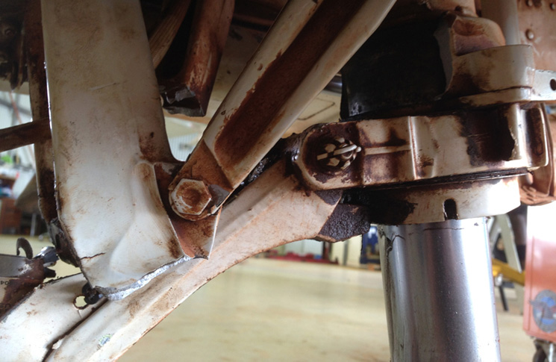
Landing gear corrosion
www.flightsafetyaustralia.com
17 Jan – 25 March 2014

Slide 8
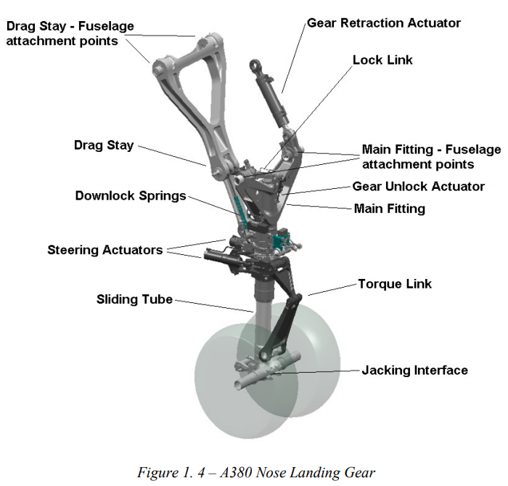
Anatomy of a landing gear
https://core.ac.uk/download/pdf/14697838.pdf

Slide 9
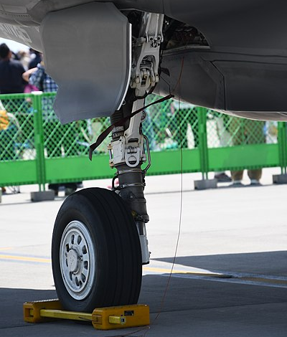
Drag brace
Lower drag brace Main LG
https://upload.wikimedia.org/wikipedia/commons/thumb/4/49/U.S._Marine_Corps_F-35B_Lightning_II%28169164%29_of_VMFA-121_right_main_landing_gear_right_front_view_at_MCAS_Iwakuni_May_5%2C_2018_02.jpg/400px-U.S._Marine_Corps_F-35B_Lightning_II%28169164%29_of_VMFA-121_right_main_landing_gear_right_front_view_at_MCAS_Iwakuni_May_5%2C_2018_02.jpg

Slide 10
Cd replacement with ZnNi – sacrificial protection
REACH - Registration, Evaluation, Authorisation and Restriction of Chemicals
EOSH - Environmental and Occupational Safety and Health
EPA – Environmental Protection Agency
Replacement with ZnNi
  Thickness distribution
  Composition

Slide 11
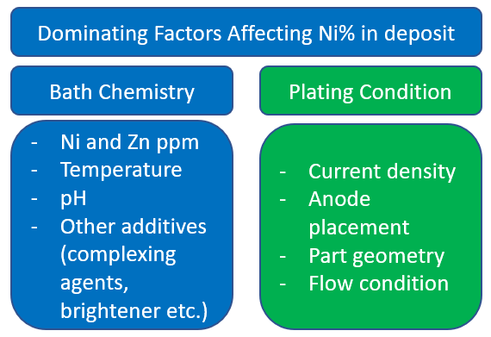
Factors known to affect Ni content in ZnNi alloy

Slide 12
Impact of ZnNi composition
Alkaline LHE ZnNi chemistry and corrosion resistance as a function of wt% Ni. (Bjorn Dingwerth, Atotech, SURFIN (2012).

Slide 13
Modeling approach - electrochemistry
Primary Current Distribution accounts solely for electrical transport losses due to resistance. These simulations refrain from solving species concentrations. When temperatures are fixed only one (PDE) is solved for the electric potential, thus reducing the computational effort significantly. Neglecting activation overpotentials corresponds to assuming an infinite electrochemical reaction rate where all significant losses occur in the electrolyte and/or in the metal transport of charge carriers.
Secondary current distribution setups build on primary current distribution, but additionally account for activation overpotentials. These simulations do not resolve species concentrations, assuming a perfectly mixed electrolyte.
Tertiary Current Distribution the most detailed modelling approach, where reaction rates and overpotentials are concentration dependent requiring the highest computational effort. For isothermal tertiary, one PDE is solved for each species. These PDEs depend on flow velocities, so, three additional equations are solved for U, V, W plus pressure, in addition to the PDE for electric potential. Thus, the tertiary setup requires solution of at least 5+n PDEs, whereas the primary and the secondary setups are required to solve only one.
Siemens Star CCM+ v2019.2
https://www.plm.automation.siemens.com/global/en/products/simcenter/STAR-CCM.html

Slide 14
Modeling approach - plating
Gather solution data – Hull cell experiments
  Anodic & cathodic data
  Plating efficiency
CAD geometry of plating tank
Insert CAD geometry of component to be plated

Slide 15
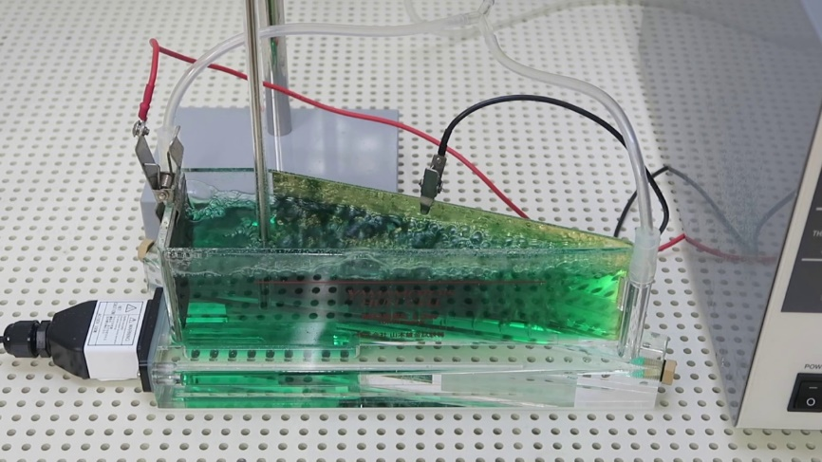
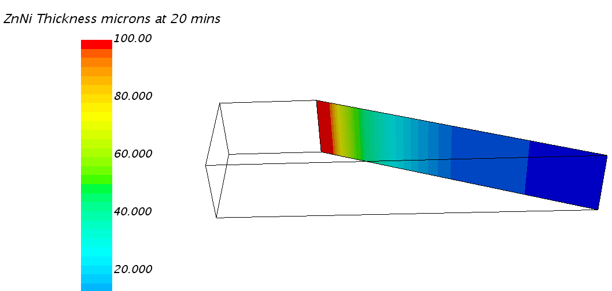
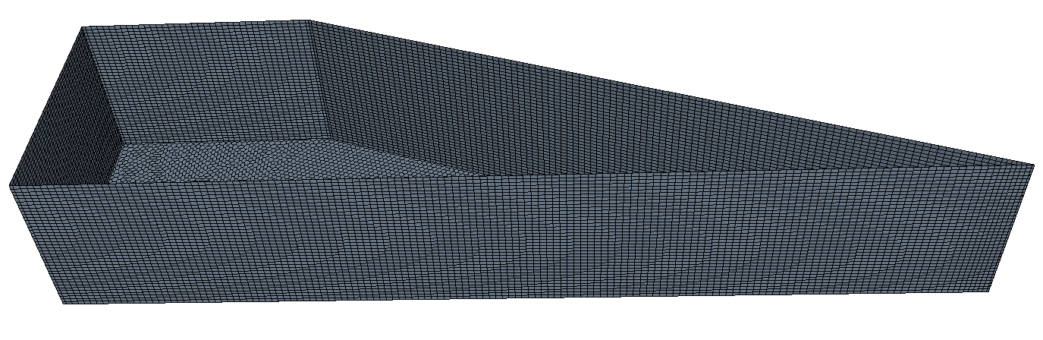
Hull cell – plating data
anode
cathode
www.yamamoto-ms.co.jp
Corrdesa Hull cell model

Slide 16
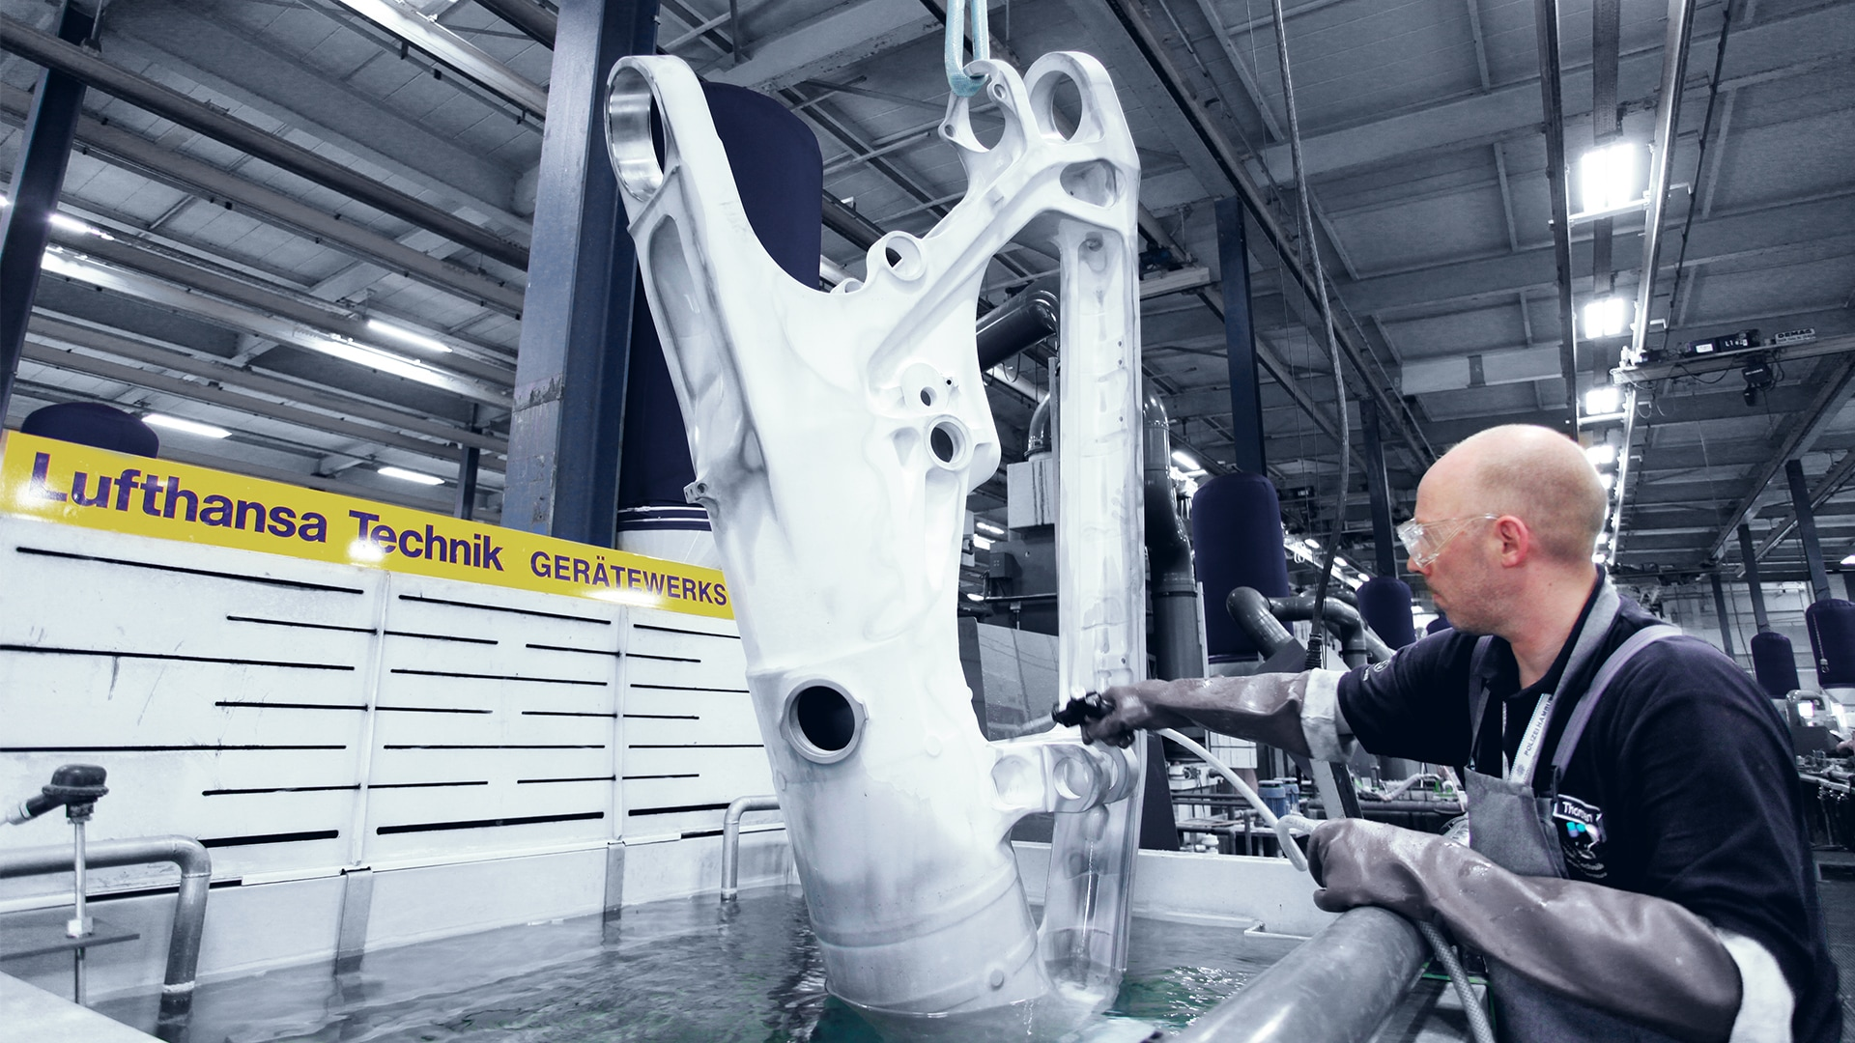
Landing gear in plating tank
https://www.lufthansa-technik.com/documents/5875801/6300210/090910_Galvanik++64461_16x9.jpg/692b1cb1-a8f5-4d66-bea3-2f1089e45908?t=1539967084906

Slide 17
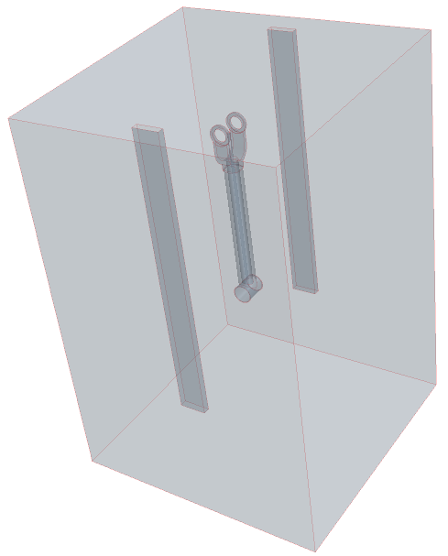
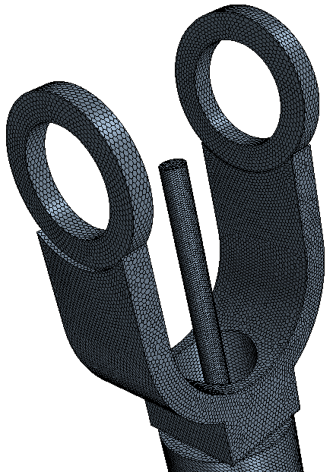
Surrogate geometry and plating tank
Surrogate
drag brace
Representative auxiliary anode tooling, assumed connected to main power supply.
Other auxiliary anodes not included
Tank anodes

Slide 18
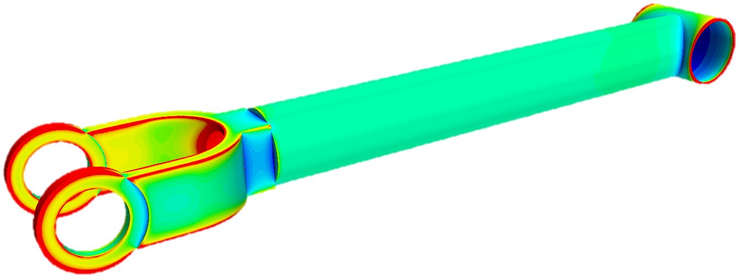
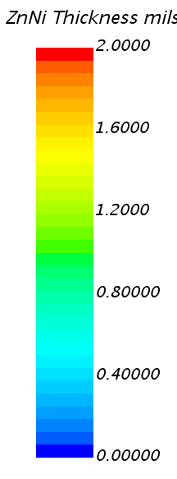
Thickness variation

Slide 19
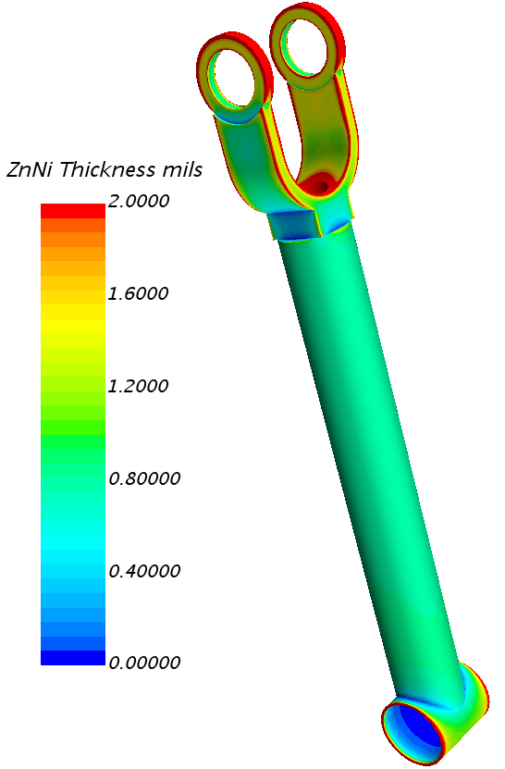
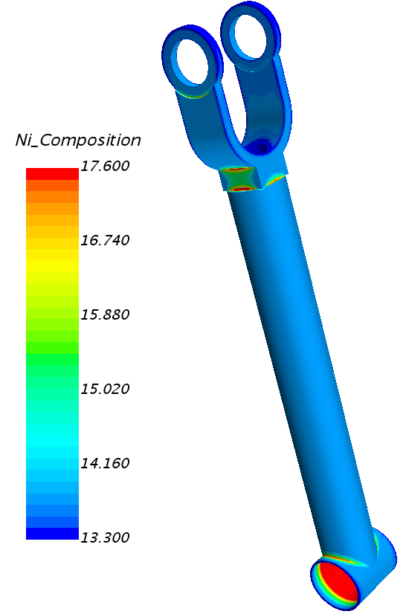
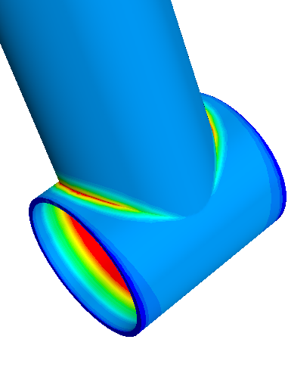
ZnNi thickness & composition with auxiliary anode
Very important: Low current density gives low thickness with high Ni%

Slide 20
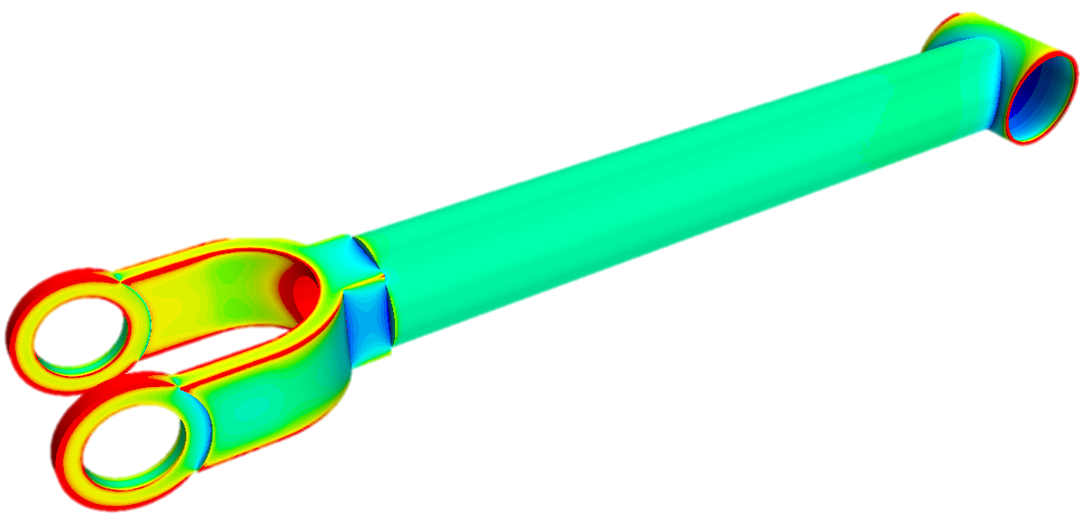
Post plating measurement
XRF measurement confirms Ni content within 12-16% range, BUT
  Variations on edges and in recesses
  Cannot measure locations where thickness and Ni% vary most
Better QA if can relate to the worst or most sensitive areas
Beware: Some aerospace materials contain Ni, which can affect measurements, such as A100 is 11% Ni, 300M is 1.8% Ni
Within allowable range

Slide 21
Modeling approach - corrosion
Gather material polarization data – potentiostat expt
  Anodic & cathodic data
CAD geometry of component
Wrap CAD component in fluid shell (electrolyte film)
  3.5% NaCl solution to represent maritime
  5% NaCl solution to represent ASTM B117 chamber

Slide 22
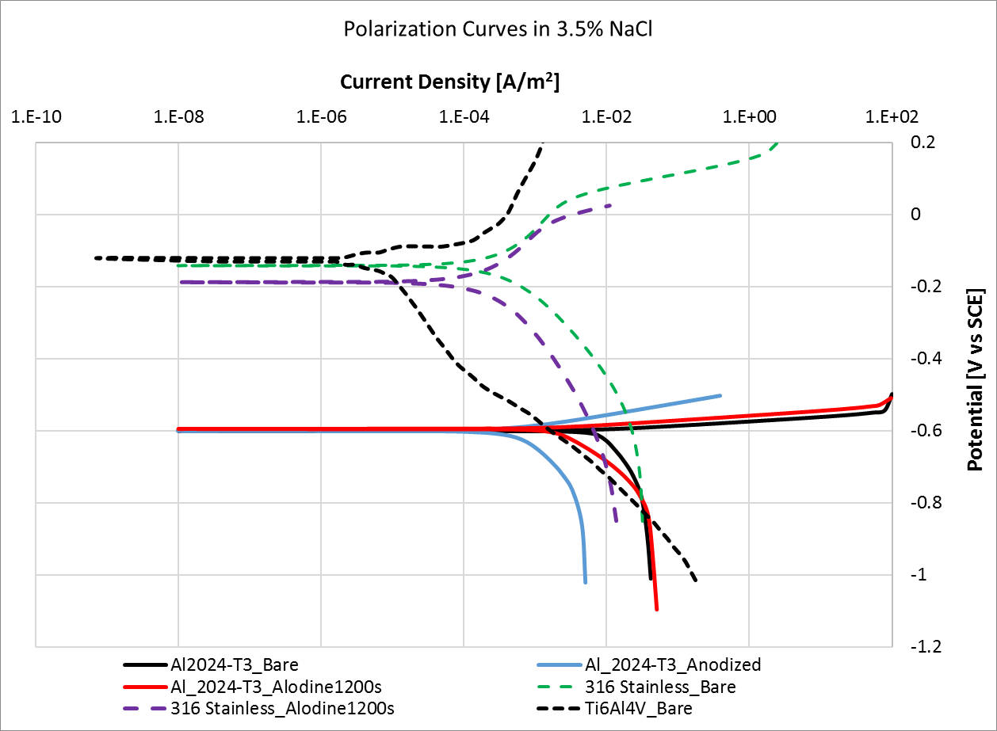
Polarization curves
Despite the potential difference between Ti/Al being larger than that between SS/Al, the SS galvanically corrodes the Al at an order of magnitude faster rate.
ΔE _{Ti/Al}
ΔE _{SS/Al}
Ti/Al
SS/Al

Slide 23
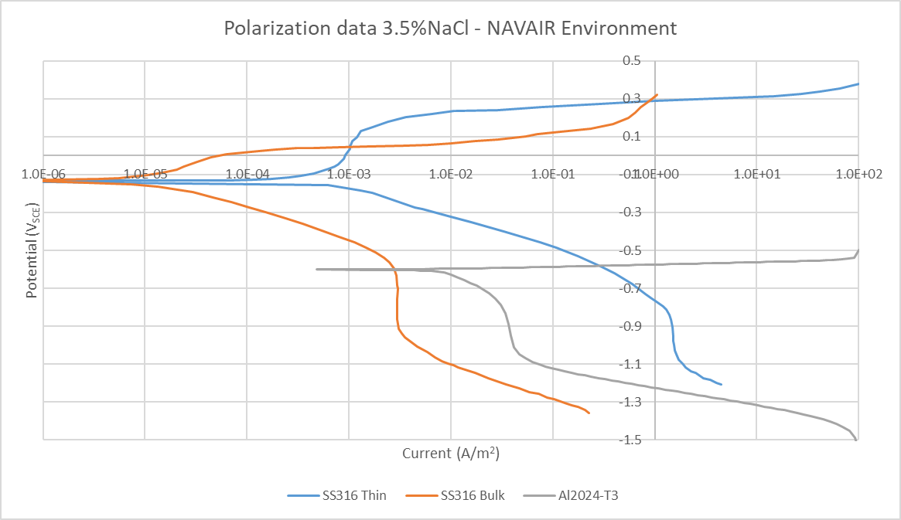
Maritime environment
25ºC

Slide 24
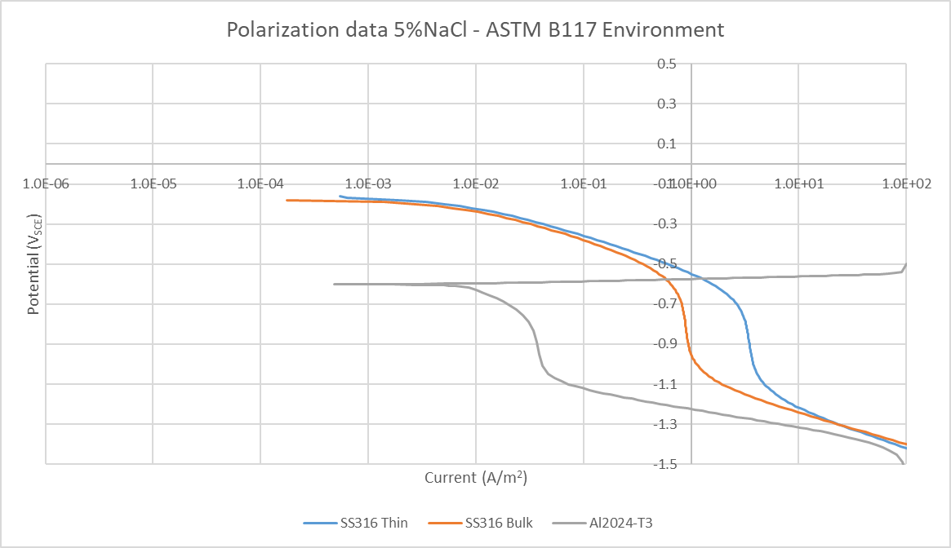
Chamber environment

Slide 25
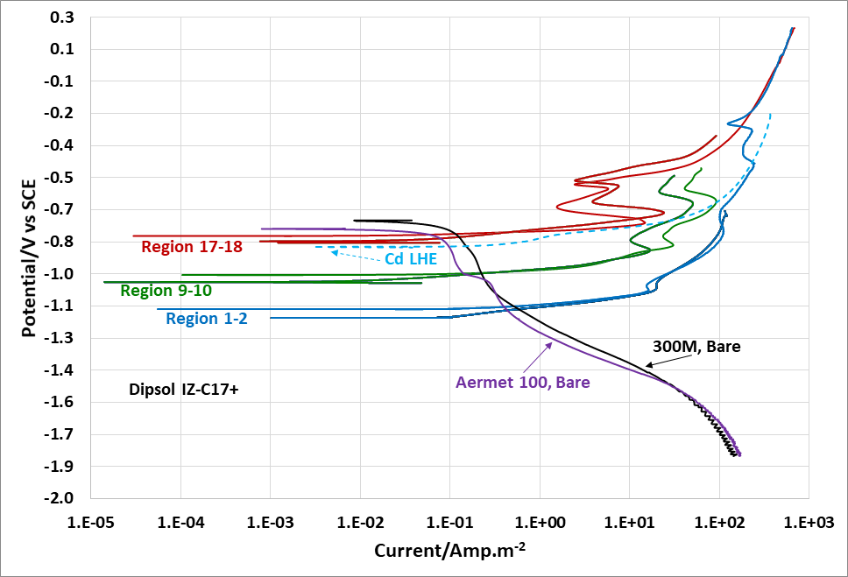
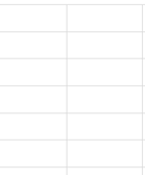
ZnNi polarization for different Ni content
Less noble ZnNi

Slide 26
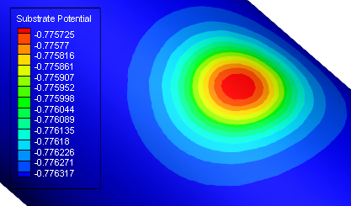
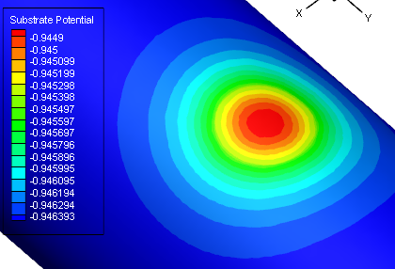
ZnNi plated Aermet 100 – with defect
More noble ZnNi
For the more noble ZnNi the average potential of the exposed Aermet 100 in the defect is -776mV (just 46 mV below its OCP) compared to -945mV (215mV below OCP) in the case of the less noble ZnNi coating.
What this means is that the less noble ZnNi coating brings down the Aermet potential 215mV (on average) below its OCP, firmly placing the material into the cathodic region and protecting it ‘cathodically’.
Whereas, the more noble ZnNi only brings down the Aermet potential by 46mV, providing little protection.
Less noble ZnNi

Slide 27
Impact of Ni varying composition
More noble ZnNi provides less protection… where more strength is required!
So this could be addressed by design and placement of auxiliary anodes

Slide 28
Verification & Validation
Plating
  Hull cell measurements
  also can measure thickness and composition on actual plated components (proprietary data)
Corrosion
  Controlled beach and environmental chamber
  Measurements from actual field components

Slide 29
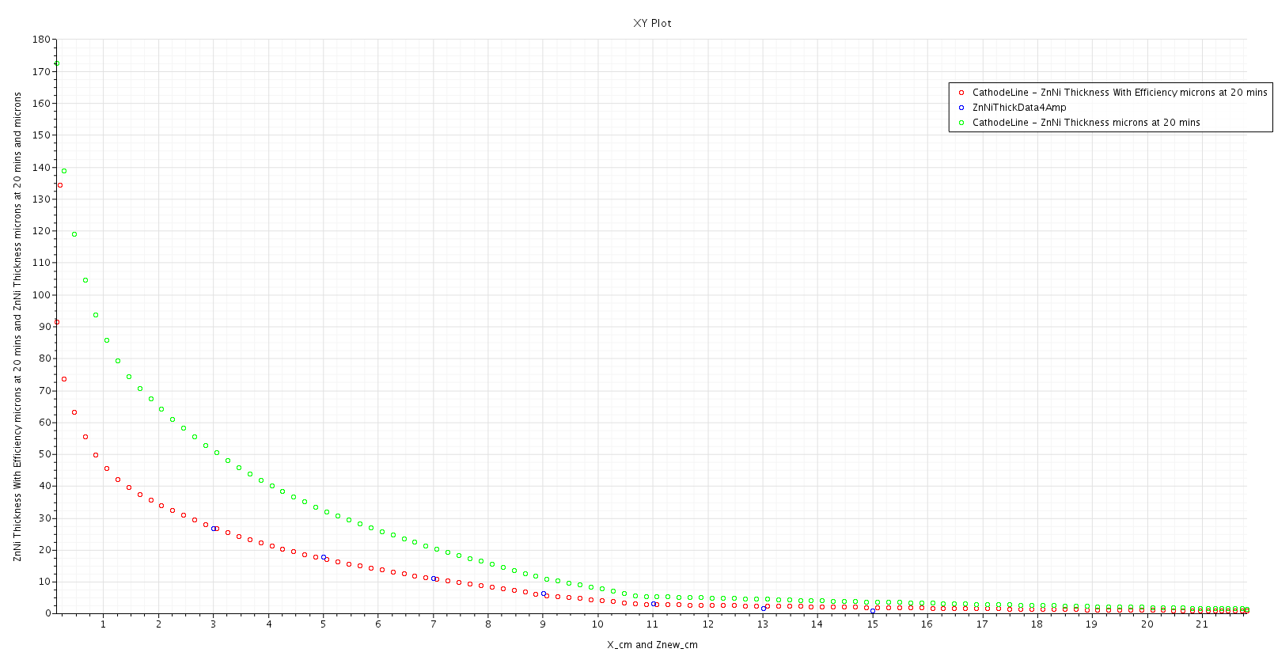
Hull cell: Comparing prediction and measurement
Without plating efficiency
Implementing plating efficiency term
Experimentally measured data points (in blue)

Slide 30
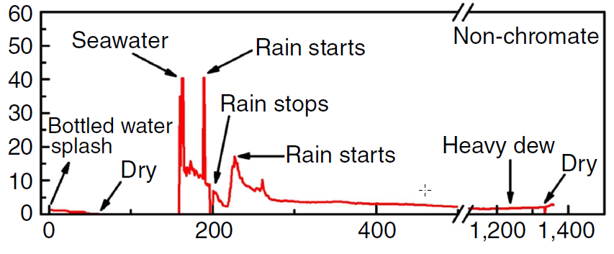
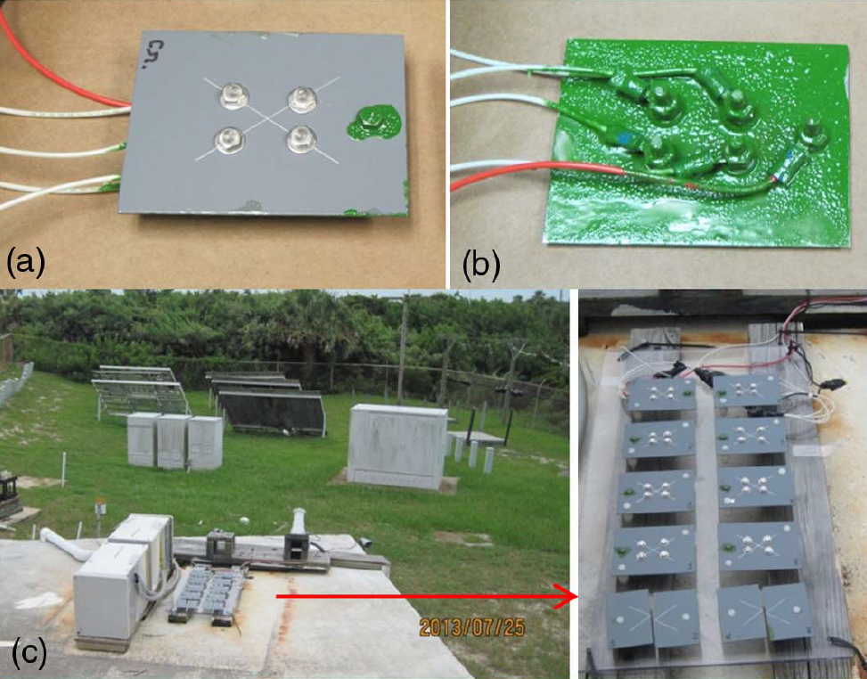
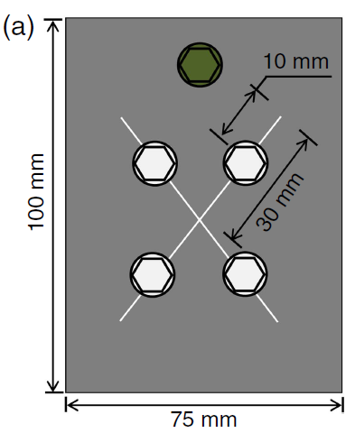
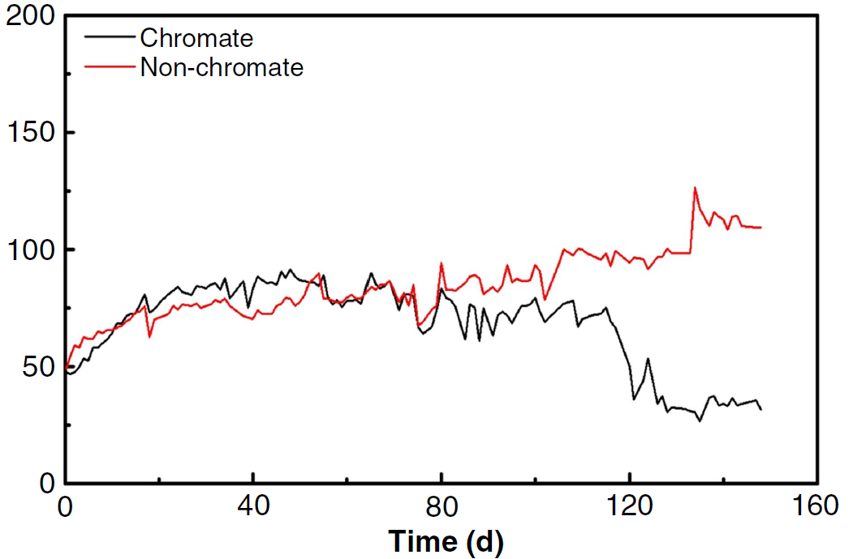
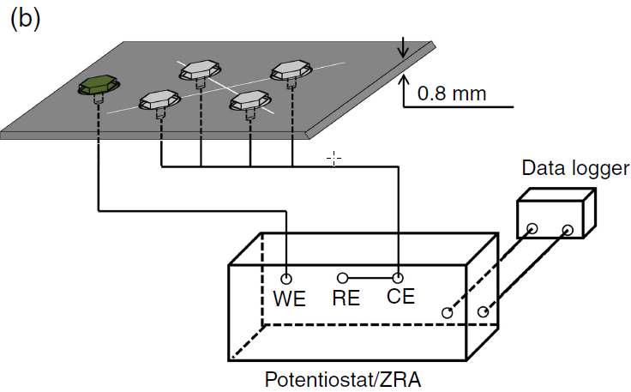
ASTM B117 vs Fielded Coupons
Fastener corrosion current µA
Fastener corrosion current µA
Z. Feng, G.A. Frankel, W.H. Abbott, C.A. Matzdorf, “Galvanic Attack of Coated Al Alloy Panels Laboratory and Field Exposure”, Corrosion 72 (2016); p. 342.

Slide 31
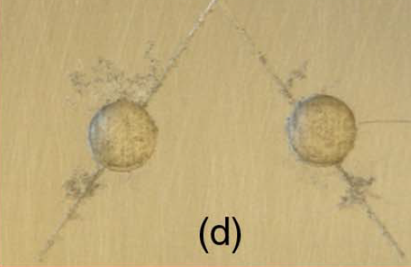
Current density & corrosion

Slide 32
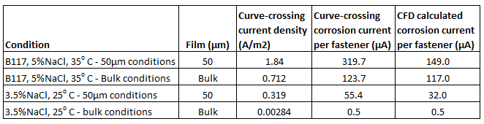
Model comparison
Chamber
Fastener corrosion current µA
Beach
Fastener corrosion current µA

Slide 33
Summary
Corrosion is a cost and safety issue. Many coatings are hazardous and are presently being replaced
Cd is toxic sacrificial coating and can be replaced with ZnNi
ZnNi, being an alloy is more difficult to plate but simulation can establish optimum parameters
Corrosion simulation can then assess corrosion resistance of the plated coating
What does it mean for OEMs?
Supplier setup qualification
  Define allowable thickness/chemistry variations, QC locations
  Check validity of plating set up to stay within allowables
    Including auxiliary anodes and chemistry maintenance
QC/QA
  Define test locations – thickness, Ni%
  Establish consistency across supplier network

Slide 34
Thank You!
Alan Rose, Corrdesa LLC, Tyrone, GA, USA
arose@Corrdesa.com
770 683 3960

